Slide 1
Horticulture
Skilled Trades Industry

Slide 2
What is Horticulture?
Horticulture comes from the Latin words hortus which means “garden” and colere which means “to cultivate” – cultivation or culture of a garden
With time, the term horticulture has acquired a broader meaning, for instance, when we talk about horticulture we are referring to the production and use of plants for food, beauty and other benefits for society
Science and horticulture are directly connected with botany being the most related
Botany is the study of plants and their processes
Horticulture Science is the field that study the cultivation of horticulture plants
The process of applying science to horticulture is called Horticulture Technology

Slide 3
Divisions of Horticulture
Floriculture
Landscape and Nursery
Arboriculture
Olericulture
Pomology

Slide 4
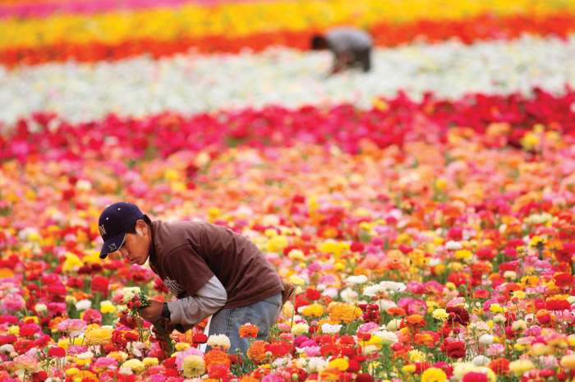
Floriculture
Floriculture, or flower farming, is a discipline of horticulture concerned with the cultivation of flowering and ornamental plants for gardens and for floristry, comprising the floral industry.

Slide 5
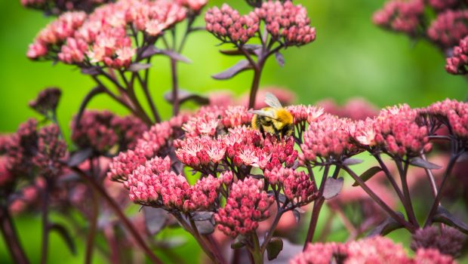
Landscape and Nursery
The Landscape and Nursery industry is the science and practice of propagation, growing, planting, maintaining, and using annuals, perennials, grasses, shrubs, and trees to create beautiful landscapes.
https://bclna.com/

Slide 6
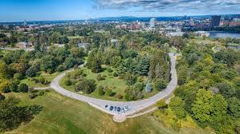
Arboriculture
Arboriculture is the cultivation, management, and study of individual trees, shrubs, vines and other perennial woody plants.

Slide 7
Olericulture
Olericulture is the science and practice of growing, harvesting, storing, processing and marketing vegetables.

Slide 8
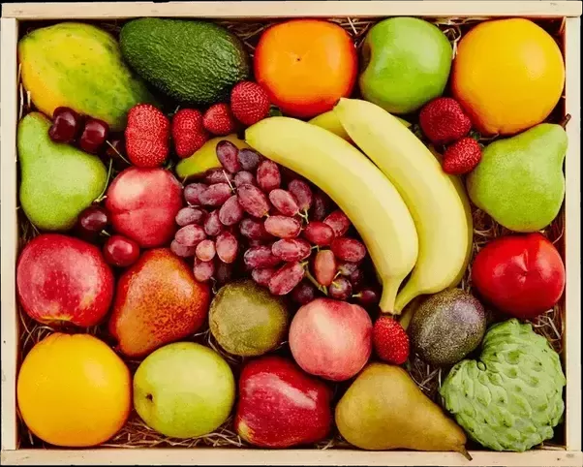
Pomology
Pomology is the science and practice of growing, harvesting, storing, processing and marketing tree grown fruits.

Slide 9
Importance of Horticulture
Economic
Provides jobs
Aesthetic
Improves the appearance of homes and buildings through landscaping
Environmental
Cleans air
Produces food (fruits, vegetables, nuts)
Increases value of homes through landscaping
Improves the appearance of land from fruit, vegetable and ornamental crops grown
Prevents erosion
Provides shade
Nutrition

Slide 10
Necessary skills to find employment in the horticulture industry
Skills vary from unskilled to highly skilled depending on the career in horticulture
Excellent planning skills
Ability to organize and manage your own workload
Problem-solving ability
Communication and interpersonal skills
Ability to work in a team and use your initiative
A hands-on, practical and realistic approach to work
Flexibility and a willingness to work in a busy and varied environment
Knowledge of health and safety regulations and procedures
Physical fitness and the ability to work in physically demanding environments

Slide 11
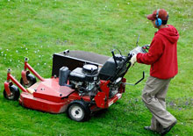
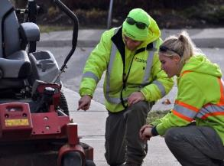
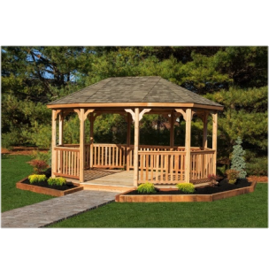
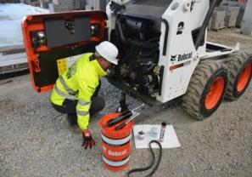
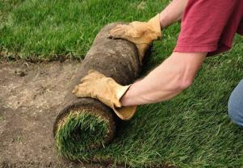
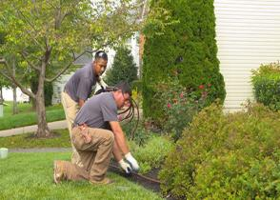
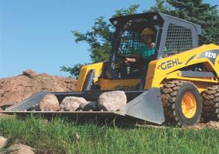
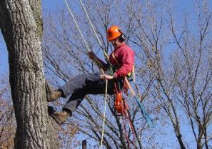
Entry Crew Member
Horticultural Technician
Crew Leader/Foreman
Supervisor
Landscape Manager
Nursery Worker
Carpentry
Small Engine Technician
Turf Specialist
Irrigation & Plumbing
Landscape Designer
Hardscape & Masonry
Pool/Hot Tub Installer
Lighting & Electrical
Equipment Operator
Arborist
Snow & Ice
Garden Center Sales
Notes:
We just talked about what the profession does and what positive changes you can make by working in this field as well as highlighting just 3 of the millions of projects completed by Landscape Horticulture Professionals!
Now I want to share with you what we call the “perfect storm”: an amazing opportunity that you can all take advantage of!
Because of growing concerns for climate change and the need and desire to improve and maintain the green infrastructure around us to mitigate the effects of climate change we are faced with career opportunities for those passionate to pursue them!

Slide 12
Education
YMCA YWCA
Pre-Apprenticeship Horticulture Program
https://www.ymcaywca.ca/employment-immigrant-services/services-for-job-seekers/pre-apprenticeship-horticulture-training-program/
Algonquin College
Diploma Program
https://www.algonquincollege.com/mediaanddesign/program/horticultural-industries/
Apprenticeship Program
https://www.algonquincollege.com/mediaanddesign/program/horticultural-technician/
Forestry Program
https://www.algonquincollege.com/pembroke/program/forestry-technician/

Slide 13
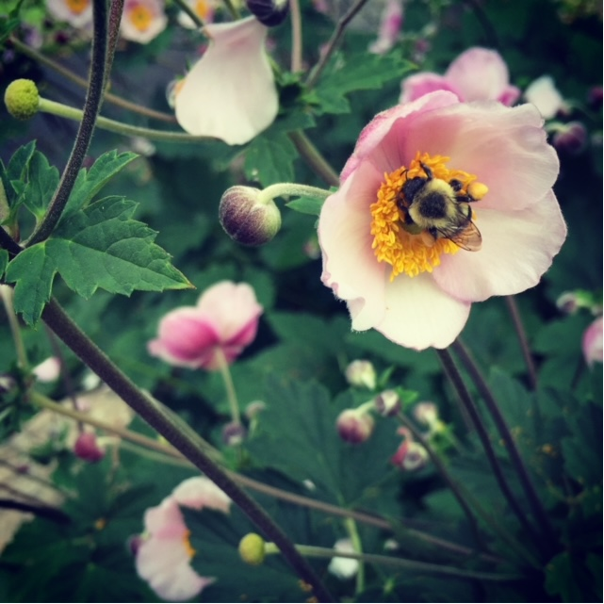
Wild Roots Floral & Garden
Consultation, Restoration, Installation, Garden Maintenance, Seasonal Containers

Slide 14
Angela Firman
Wild Roots Floral & Garden Owner/Operator

Slide 15
Plants have always been my passion so I turned it into a business that I would love.

Slide 16
Over the years I’ve worked on numerous gardens of all sizes with the ultimate goal of seeing the joy they bring to my clients

Slide 17
Now I use my knowledge and experiences to inspire students to pursue this very creative and rewarding skilled trade as a career

Slide 18
Horticulture Training Program
The YMCA YWCA Pre-Apprenticeship Horticulture Program
Duration of 26 weeks that includes:
Academic and Technical training in Horticulture
Pre-Employment Preparation
Paid Work Placement
Textbooks, Toolkit, and Safety Equipment - at no cost
First Aid & CPR, WHMIS, Worker Health and Safety Awareness in 4 Steps - at no cost
Access to Prior Learning Assessment and Recognition (PLAR) portfolio review
Co-op component with OCDSB
The opportunity to earn up to 3 secondary school credits toward your Ontario Secondary School Graduation Diploma (OSSD)

Slide 19
For more information
please contact us:
Daniela Renderos
Job Developer
daniela.renderos@ymcaywca.ca
Angela Firman
Technical Teacher and Job Developer
angela.firman@ymcaywca.ca
Horticulture Telephone: 343-961-4256

Slide 20
Floral Arrangement

Slide 21
Harvest Workshop

Slide 22
Spring Planter

Slide 23
Summer Window Planter

Slide 24
Summer Planter

Slide 25
Winter Arrangement

Slide 26
Garden Installation & Maintenance

Slide 27
Commercial Garden Installation

Slide 28
Mosaiculture

Slide 29
Thank you for joining me today!

